Slide 1

CA Terminal App Hangman
By Mark Ying

Slide 2
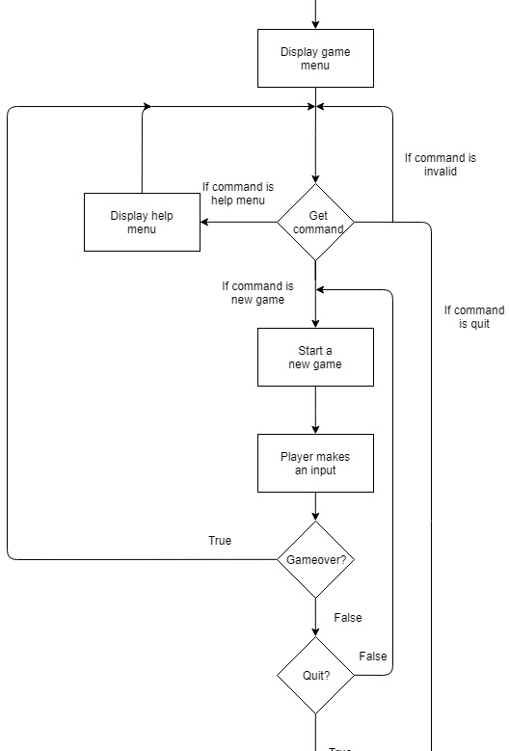
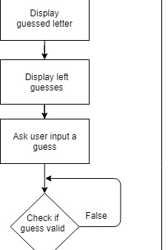
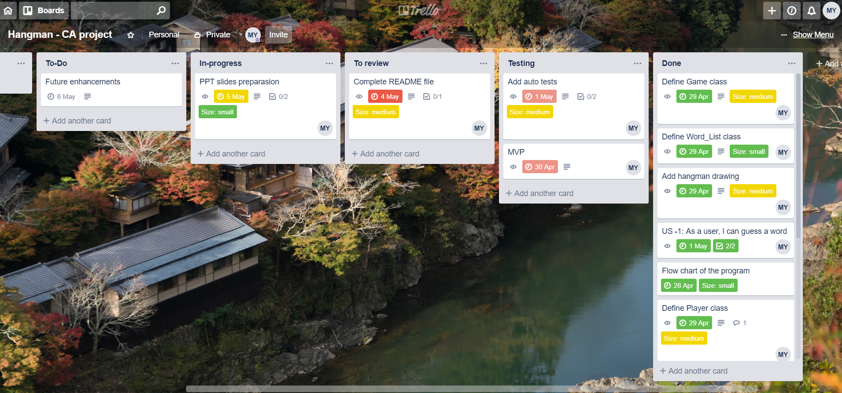
Project plan

Slide 3
Legal and ethical issues:
Offensive words
Uncomfortable with hangman drawing

Slide 4
Challenges and favourites
Keep the code dry
Adjust the code structure
Explore new features
Breakdown problems

Slide 5
